Slide 1

Contributions to Contrast Finder
By Lexus Hartung, Steven Higgins, and Levi Hagan

Slide 2
So, What is Contrast Finder?
An open source software project that seeks to make the web more accessible for people with colorblindness.
This software takes in the colors of text and the background that text will be displayed on and spits out suggestions that would provide a greater contrast between those two colors.

Slide 3
A little History
First lines of code were made in 2006 under a project named CCT
The code was refactored in 2013 as a side project for Tanaguru. This is when it was given the new name Contrast-Finder.
Tanaguru collapsed, And was reworked into another company called Asqatasun, which is the organization that currently manages contrast finder
We worked on the Asqatasun repository for this project, due to it still being active, but this software's long journey just speaks to the resilience of opensource software.

Slide 4
What Was needed to work on This?
A Virtual Machine
Java
Git
Docker
Source Code from the Contrast Finder Github: https://github.com/Asqatasun/Contrast-Finder

Slide 5
Our First Project (And how that didn’t work out)
Our project first project was OpenMRS, a database that is meant to connect doctors all over the world.
This project required MySQL, Mavin, and optionally tomcat
Unfortunately, MySQL was not cooperative, taking too much space on one person's machine and just not getting along with the web server on another’s.
Lesson #1 know when to bail.

Slide 6
Getting back on track
Once we picked a new project, not everything was rosy.
One members computer was at the shop for this first deliverable, and another couldn’t get their virtual machine to work so we got very lucky to get contrast finder up and working at all.

Slide 7
First Deliverable: Successes
Despite all the setbacks, Lots of successes were also found this first deliverable!
Once contrast finder was up and running, it automatically ran 15 well documented tests. It was these tests and the little print outs that come with them that made our future job of designing tests much easier.

Slide 8
Second Deliverable: Challenges
Our first challenge was getting one of our teammates virtual machines working
In the middle of this deliverable another team members computer finally returned from the shop, so our next challenge was catching them up.
Finally, we had to really establish a schedule for working together on this project outside of school time, which was no easy feat with three busy college kids.

Slide 9
Second Deliverable: Successes
We came together and made a very comprehensive test plan that gave us a great document to go back to when ever we wanted to know what we should be working on.
We also got all the members computers to finally cooperate so we could work at maximum efficiency for the next deliverable
Lesson #2: Working together makes things go much smoother

Slide 10
Third Deliverable: Challenges
The biggest challenge was most of the team not knowing bash. We did our best to teach ourselves from the resources provided before hand, but you never really learn something until you get hands on with it.
We also had trouble getting java to recognize our copies of Contrast Finders code as packages that the drivers would need to import
Lesson #3: Get Coding if you want to learn a new language

Slide 11
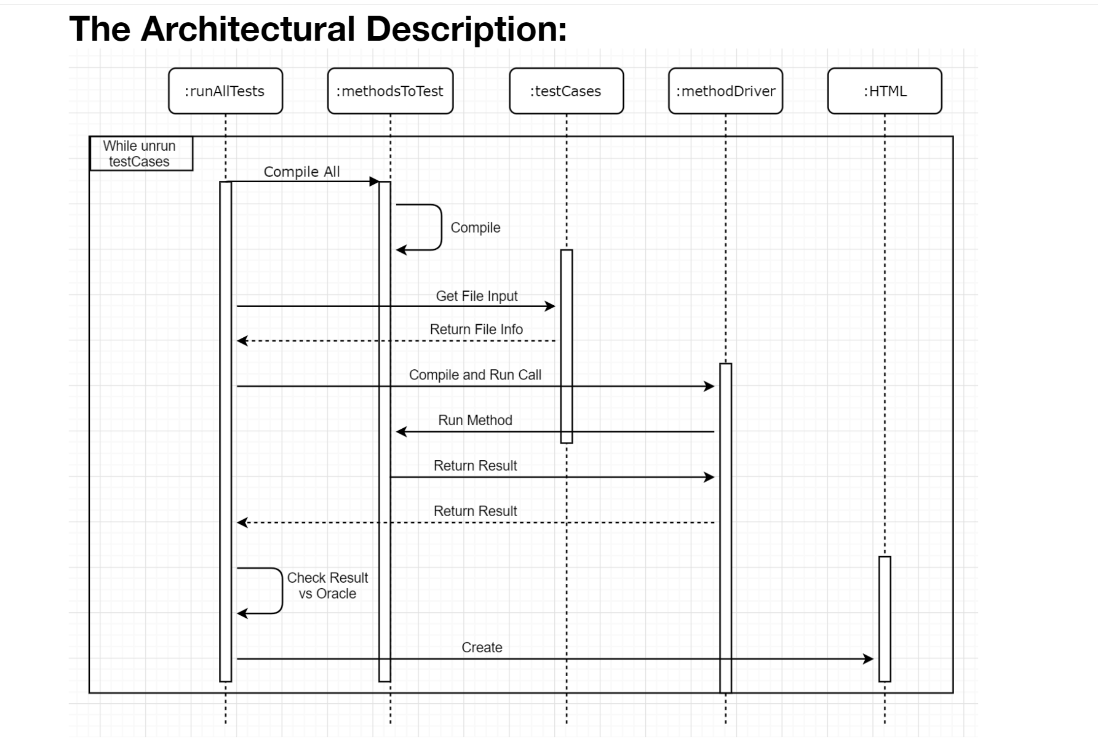
Third Deliverable: Successes
Even with our inexperience we got the runAllTests script up and running along with two test drivers.
We also got a nice SSD of how the system was working, helping all the team members to better understand the greater whole of what we were working on
Though both the testing script and the drivers would need to be edited later to fall in line with requirements it was very encouraging to see them working at this stage

Slide 12
Fourth Deliverable: Challenges
We realized our RunAllTests script and drivers weren’t interacting in the correct ways and had to make some tweaks so that writing future drivers would be easier. Making the RunAllTests script check the oracle wasn’t difficult, but it did require a lot of little changes.
We also realized one of the test drivers we had picked early on to work on was a private method, so we had to find a new candidate for testing.

Slide 13
Fourth Deliverable: Successes
Once RunAllScripts was formatted more cleanly, It was a breeze to make the last three test drivers.
Having everything running, and the HTML correctly formatting the results at this point was just phenomenal. Very cool to see everything come together

Slide 14
Fifth Deliverable: Challenges
Even at this stage we found we had put too much responsibility on the drivers, and thus had to put more functionality into the runAllTests script once again. Taking the responsibility of formatting away from the drivers and putting it on the runAllTests script was difficult but we got it done.
Lesson #4: Read Requirements Carefully

Slide 15
Fifth Deliverable: Successes
Finding the five faults to inject at this point was a cake walk.
We even had the extra time to format the HTML to look just a bit nicer.

Slide 16
What We Learned
Don’t bite off more than you can chew
Teamwork makes the dream work
Get Coding if you want to learn a new language
Diagrams help comprehension way more than you would think
Read Requirements carefully

Slide 17
Improvements for the Future
Honestly, the only regret we really have is not making a runOneTest script for debugging purposes. It was very annoying to recompile all the tests and wait for them all to execute just to see if the changes you made to one test fixed its bugs.
It would have also been a nice cosmetic change to include print statements that update the user as to how the run is going at the command line.

Slide 18
Demo Time!

Slide 19
Questions?

